Slide 1
Digital

Slide 2
Digital
Digital, however, is ultimately not about technology or data.
Digital is about serving people well.
Notes:
I am a bit immersed in this, and, maybe a little tired of the data velocity, volume, AI news cycle.
What is digital? It is about people, and in many ways. Democraticizing technology so we do not leave anyone behind (elderly, remote, disadvantaged, …)
\
Introductory briefing to the Minister of Digital Government - Canada.ca
https://www.canada.ca/en/treasury-board-secretariat/corporate/transparency/briefing-documents-treasury-board-canada-secretariat/briefing-book-minister-digital/introductory-briefing-minister-digital-government.html

Slide 3
Empower
Building Capacity
We’re empowering public servants by providing hands-on training, publishing tools and resources, and building communities.
Challenge: Hard to empower employees and teams in our governance model. What are new ways of working?
Shared responsibility model (IACA document)
Leverage partner development (IC community)
Notes:
https://www.canada.ca/en/treasury-board-secretariat/corporate/transparency/briefing-documents-treasury-board-canada-secretariat/briefing-book-minister-digital/minister-digital-government-briefing-book-cds.html
The conditions to enable successful digital services – and put users first – are not widely established across government.
Lack of digital expertise “in the room” for decision-making
Skill gap, processes, rules, organizational structures, and investments are key barriers
Central funding and oversight mechanisms incentivize large projects and compliance over outcomes

Slide 4
HSO Context
HSO challenges scope of mission, pace of world/technological change, scale of available data/information. Information sprawl growing challenging our ability to collect , analyze and draw conflusions from many disparate information sources.
HSO need security and agility in their tool set to quickly resond to mission requirements
Greater agility, collaboration, accessibility to information
Sense-making abilities lik ML & AI
IT needed
Secure, flexible, leading-edge, rapidly deployable
Global reach
Protects privacy and national security interest:
Environment: Seamless, interoperable, workflows within Canada & FVEY

Slide 5
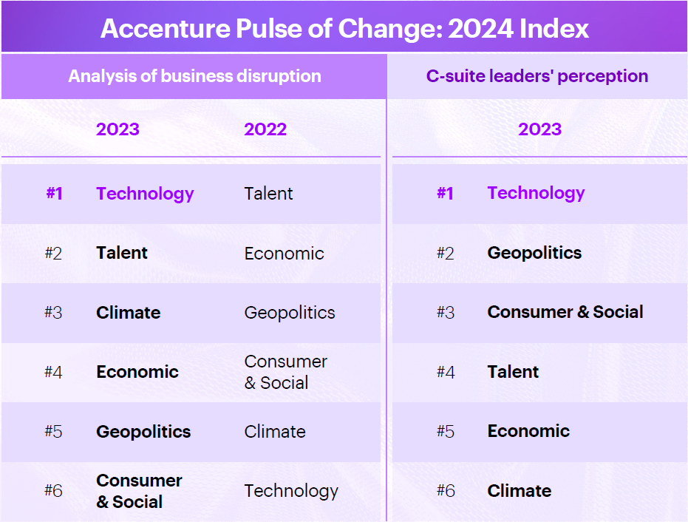

Slide 6
Technology was the top cause of change in 2023
Driven Primarily by advances in AI
Talent, Climate, Economic, Geopoliticals, Consumer & Social
Challenge: Skills shortage

Slide 7
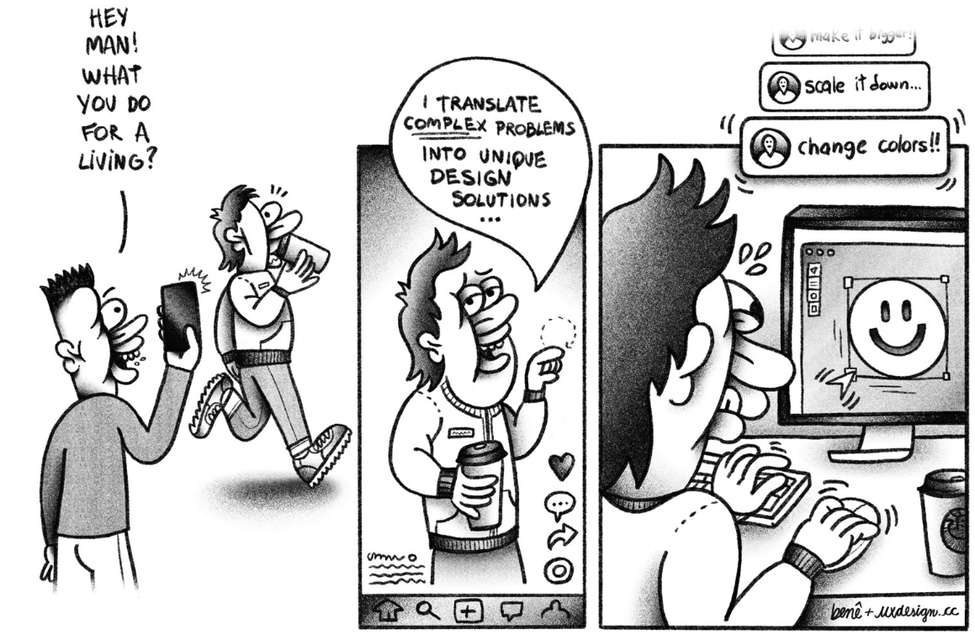
Notes:
https://trends.uxdesign.cc/
Understand how you can use your craft in a way that is not just focused on the task at hand, but also enhancing the user experience and connecting their full digital ecosystem. Solving the right problem is as important as solving it right.

Slide 8
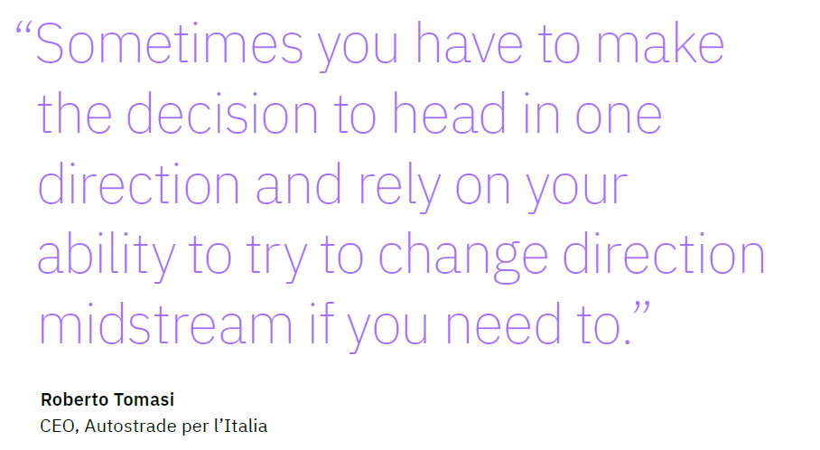
Notes:
From IBM 2024 5 Trends
The right balance of governance.
For this to work we need continuous collaboration across a broad, diverse range of interests.
Occasionally you need to “pass gates” to validate architecture, investment and program methodology
Debate & Commit

Slide 9
Collaboration > Governance
Embrace Collaboration: The more you engage with users, the easier it is to understand what they need.
Transparency: Build decisions based on data, visualizations and dashboards.
Notes:
How do we need to change our systems to enable knowledge crowdsourcing and sharing?
What level of engagement do we need with stakeholderst o achieve the EA strategic goals
How can we automate our technologies to manage low-level activities unattended
Reference: Ardoq EA Principles
…\OneDrive\Documents\GitHub\ApplicationArchitecture\ARA-TO-ADD-DESKTOP

Slide 10
